Slide 1
Pls 2000 power & politics dr. shannon
Parties and Elections

Slide 2
Parties & elections
I. ELECTIONS & ELECTORAL SYSTEMS
II. PARTIES & PARTY SYSTEMS
III. U.S. ELECTIONS
TERMS TO KNOW
Duverger’s Law Realignment
Referendum Party
Proportional Representation (PR) First-Past-The-Post (FPTP)
Electoral College Winner Take All Single Member District
Caucus Primary
Incumbent Median Voter Theorem

Slide 3
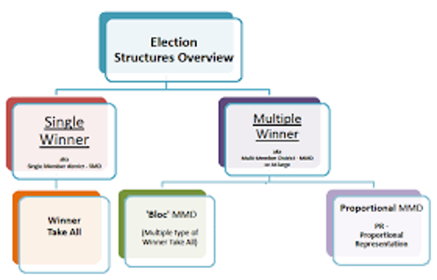
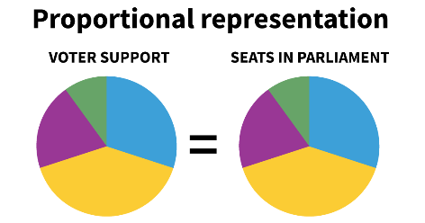
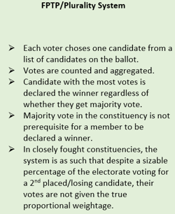
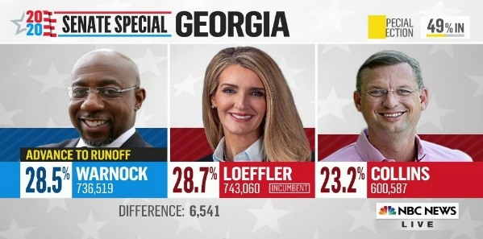
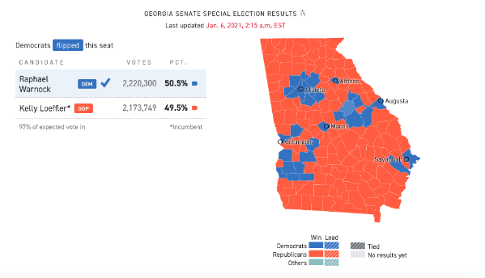
i. Elections & Electoral systems
ELECTIONS: Methods of assessing citizen preferences about candidates or policies through voting
“The determination of preferences depends on the particular procedure chosen for assessing the votes” (p.241)
ELECTORAL SYSTEMS
FPTP (First Past the Post): Plurality or majority rule, but wasted votes; disadvantages to extreme or minority views
Winner Take All Single Member Districts
PR (Proportional Representation): fewer wasted votes, more accurate reflection of preferences, but lack of majority creates need for coalitions
2-Round Voting: allows for two rounds of voting when no candidate secures an overall majority at the first attempt; the top two of the 1st round go head to head for highest vote count

Slide 4
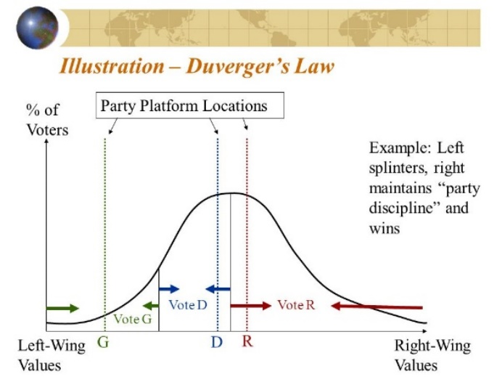
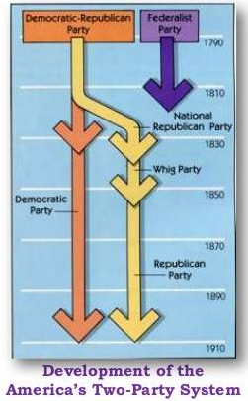
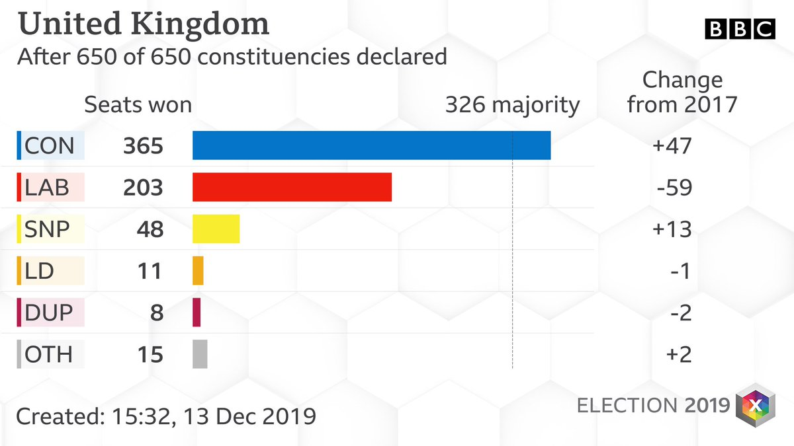
II. PARTIES & PARTY SYSTEMS
Duverger’s Law: relationship between the number of parties in a country and its electoral system.
The law was that FPTP system favors the two‐party system. winner take all single member districts compel major parties to usurp minor party messages and compete for median voter (p.254)
UK: 326 to win in 650 district elections to the House of Commons
USA “Two Party System”
Republican
Democrat
Libertarian
Socialist
Green
Progressive
https://www.oxfordreference.com/view/10.1093/oi/authority.20110803095737871
http://ww2.kqed.org/lowdown/wp-content/uploads/sites/26/2012/11/Party-Platforms-Compared.pdf

Slide 5
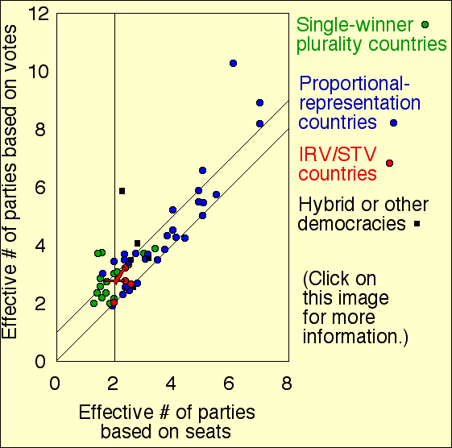
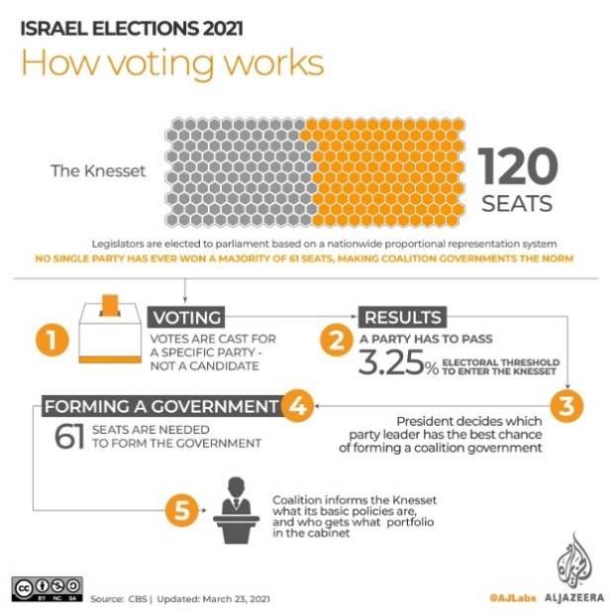
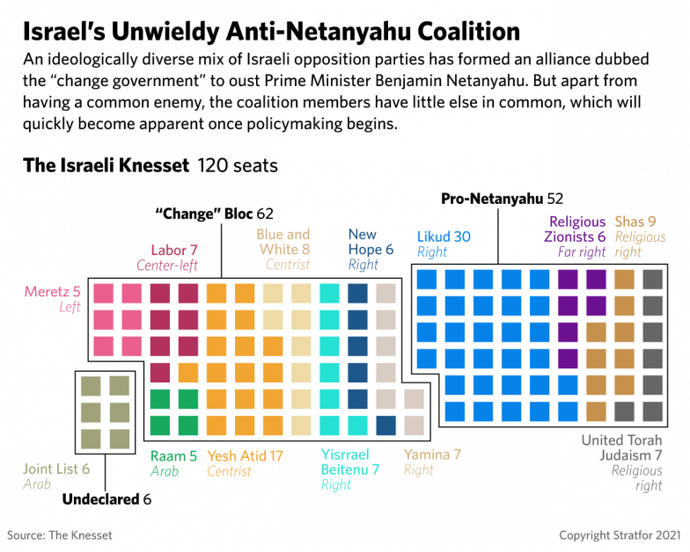
II. PARTIES & PARTY SYSTEMS
Duverger’s Law: relationship between the number of parties in a country and its electoral system.
Hypothesis: Proportional representation favors multi‐partism
parties are free to be sincere to ideology and can form coalitions to govern
The Case of Israel’s Knesset Elections
120 members from nationally elected parties via proportional representation
Electoral Threshold: 3.25% of vote to obtain seat
Coalition Government: who can get 61?
https://www.oxfordreference.com/view/10.1093/oi/authority.20110803095737871
http://ww2.kqed.org/lowdown/wp-content/uploads/sites/26/2012/11/Party-Platforms-Compared.pdf

Slide 6
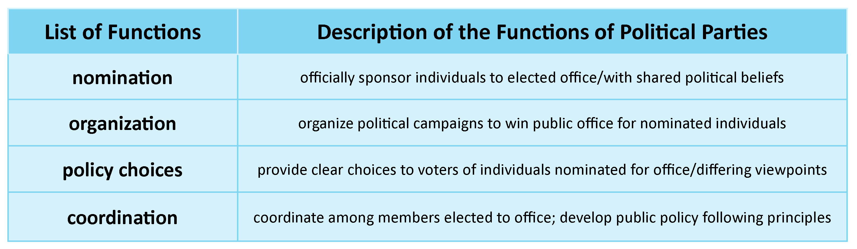
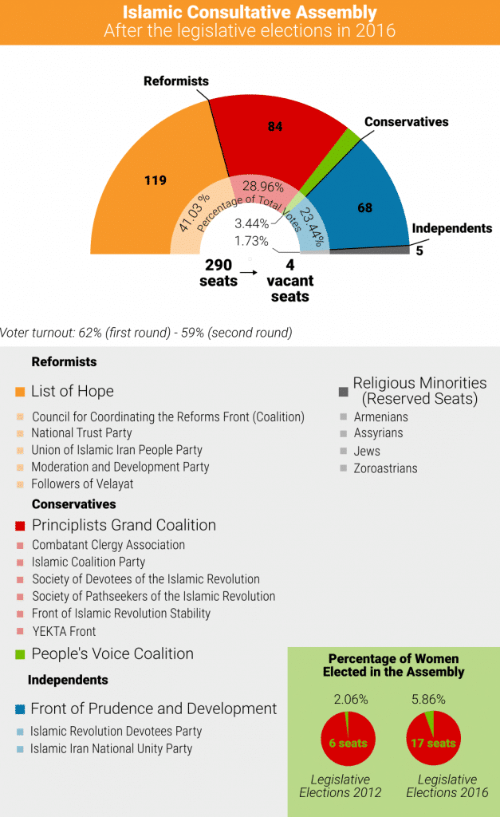
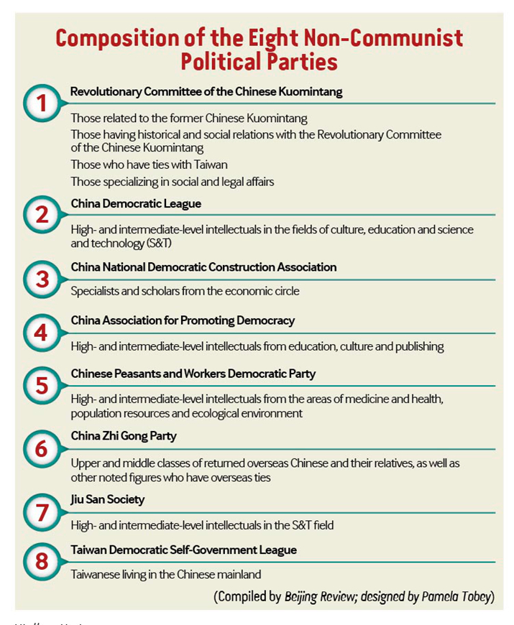
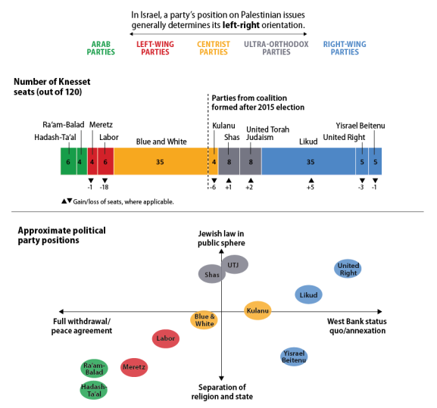
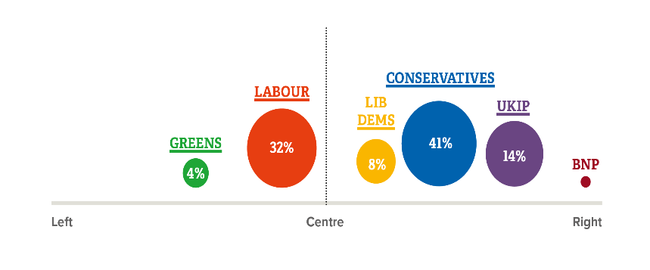
Political parties
Organizations of aggregated interests that seek influence in a state by attempting to occupy positions in government (p.248)
Functions of political parties [P.249]:
Formulation of public policy
Legitimation of the political system
Aggregating interests
Integration & mobilization of citizens
Recruiting candidates for public office
Structuring the popular vote
https://fanack.com/iran/politics-of-iran/#Political%20Parties

Slide 7
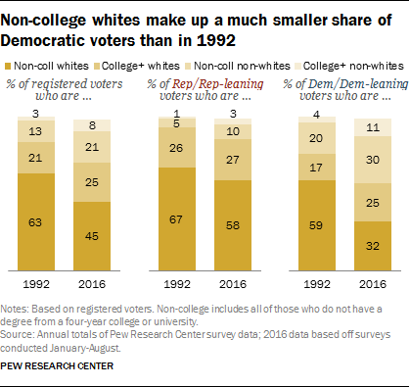
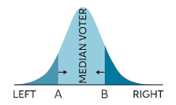
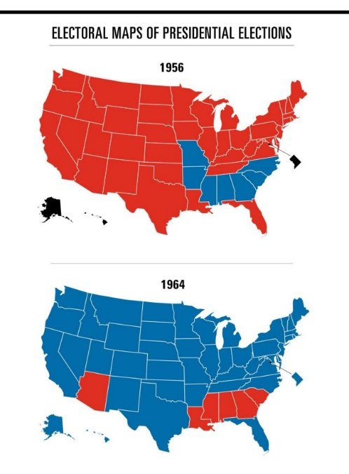
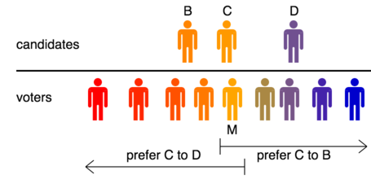
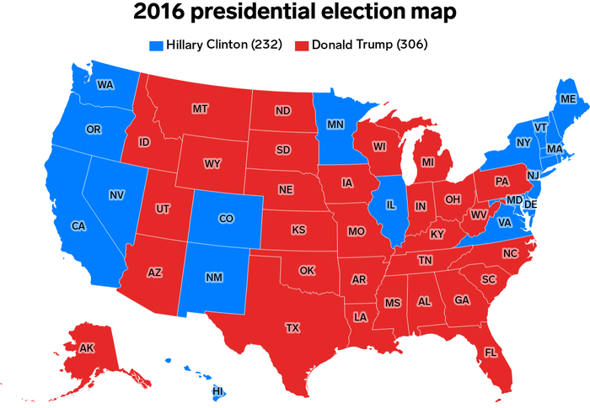
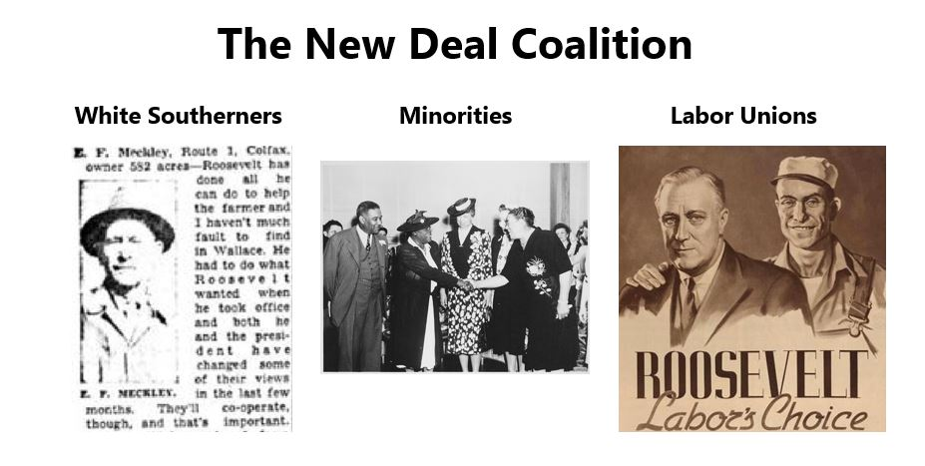
Party constituents & alignment
Which parties attract which coalition of interests?
Median Voter Theorem: during elections the contesting party or the candidate that gets elected is the one who is most preferred by the median voter
If voters choose a candidate whose views showed most “proximity” to his own, a party should take the positions most likely to convince the voter in the electorate’s ideological middle.
Realignment: structural shift in partisan electoral support
1932- New Deal Coalition
1964-1972: Dems lose Dixiecrat “Solid South”
2016 Trumpism? Populism and the “Blue Wall”
https://www.economist.com/united-states/2016/07/28/defining-realignment
https://www.chegg.com/learn/economics/introduction-to-economics/median-voter-theorem
https://stanfordmag.org/contents/what-happened-to-the-party-of-lincoln
https://www.pewresearch.org/politics/2016/09/13/1-the-changing-composition-of-the-political-parties/1_1-6/
https://janda.org/c24/Readings/Dalton/Dalton.htm

Slide 8
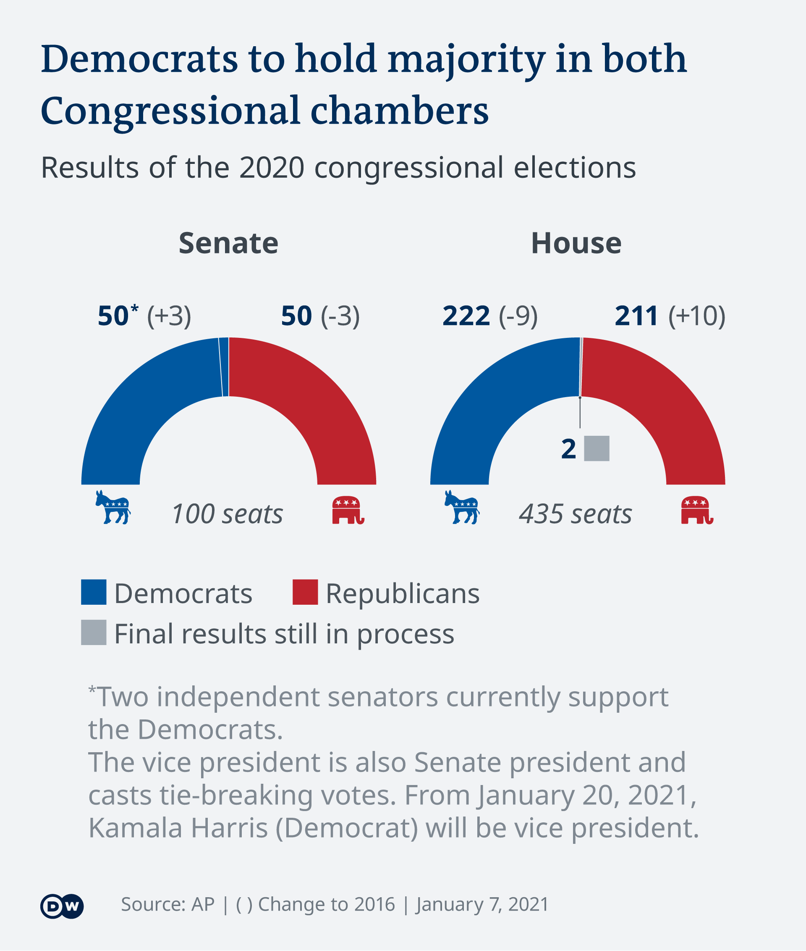
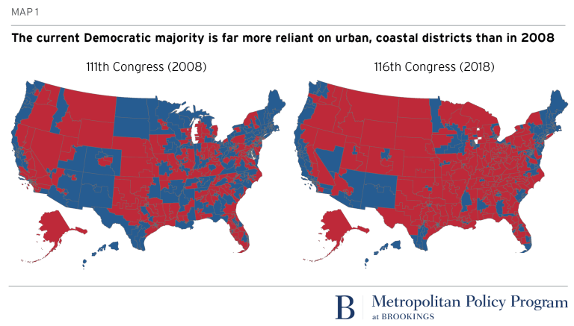
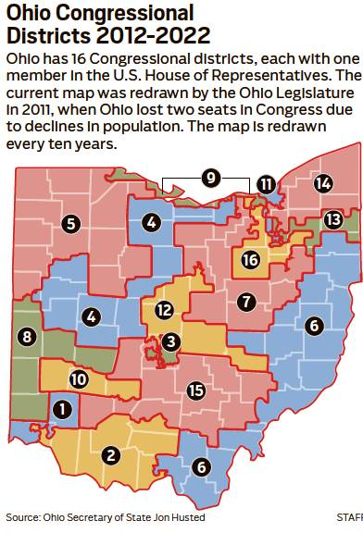
III. U.S ELECTIONS
Primary Election: Party nominees selected
General Election: Party nominees compete with others for office
FEDERAL
Congressional
House of Representatives every 2 years
Redistricting and gerrymandering
Senators every 6 years (1/3 Senate per 2 yrs)
STATE: Governor, State Senate & House…
COUNTY: Commissioner, Recorder, Treasurer…
LOCAL: Mayor, City Council, School Board…

Slide 9
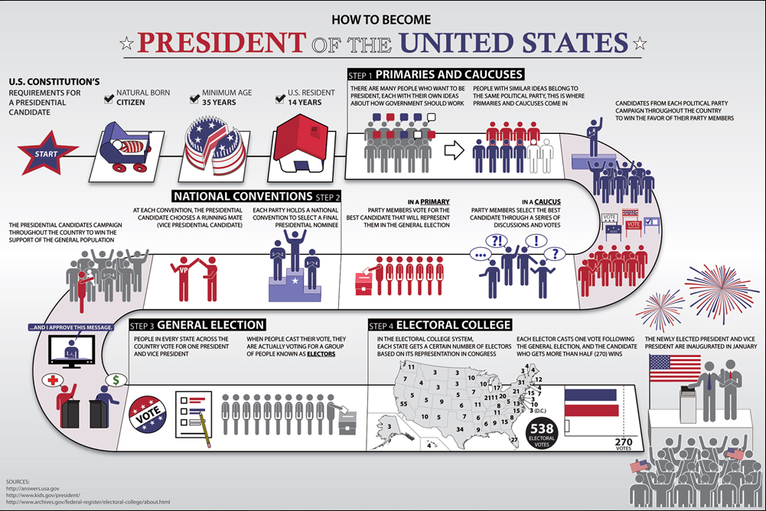
PRESIDENTIAL ELECTIONS
A. Nominating Process
B. Conventions
C. General Election
D. Electoral College & Certification

Slide 10
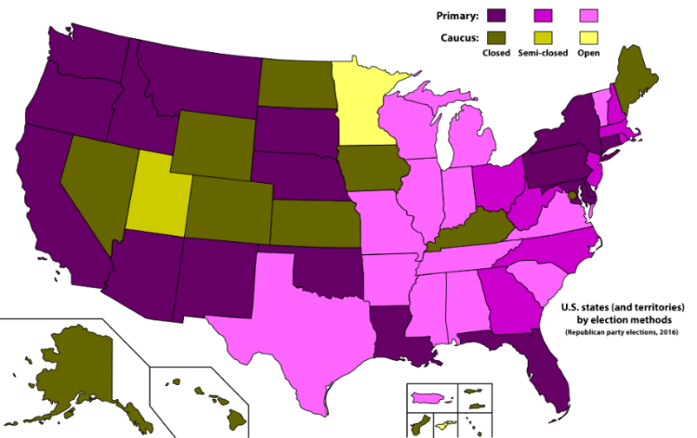
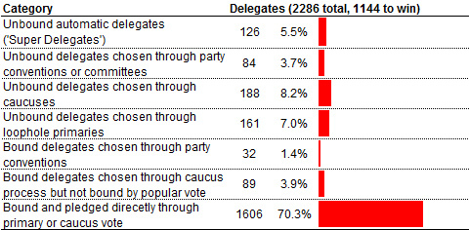
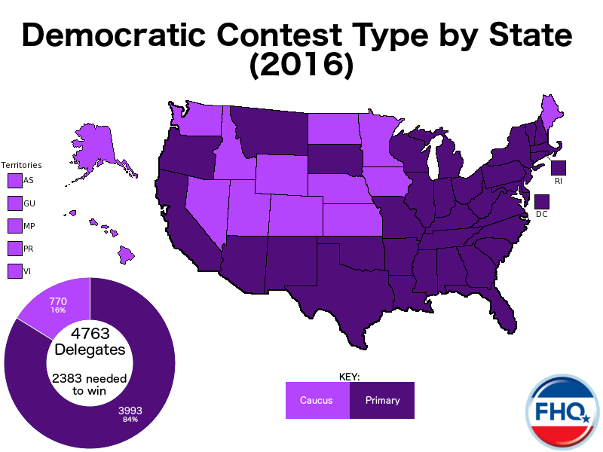
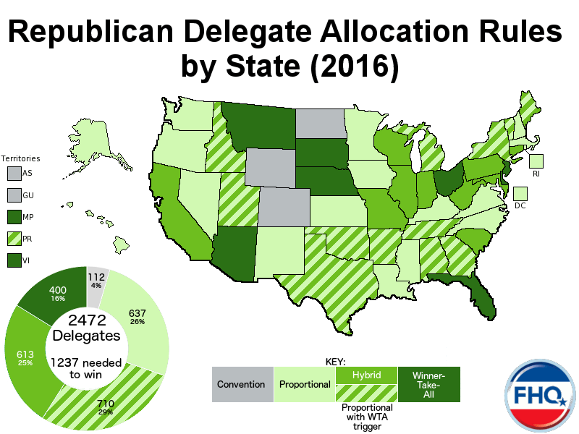
a. nominating PROCESS
States Vary on format of the vote
Primary or Caucus
Open or Closed (partisan voters only?)
Parties decide…
How many delegates for nomination
Allocation of delegates
Winner Take All v. Proportional
Superdelegates
http://www.nytimes.com/2016/04/04/opinion/the-un-democratic-party.html?_r=0
http://frontloading.blogspot.com/p/2016-democratic-delegate-allocation.html
By Ali Zifan - Own work. Used blank map from here., CC BY-SA 4.0, https://commons.wikimedia.org/w/index.php?curid=47232516
https://www.bloomberg.com/politics/graphics/2016-delegate-tracker/

